Slide 1

COMP1010 Assignment 1 Case Study 1
BEN EMERSON GROUP 9 ~ SAM DOLBEL ANDREW HARTMAN

Slide 2
Why case study 1?
What did we know about hospitals and their respected systems?
Not much.

Slide 3
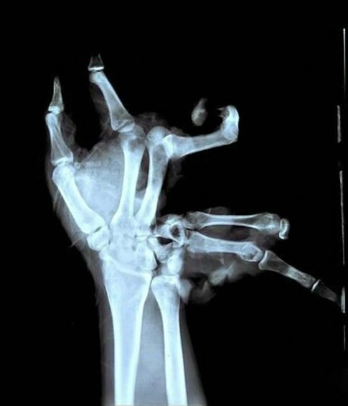

Slide 4


Slide 5
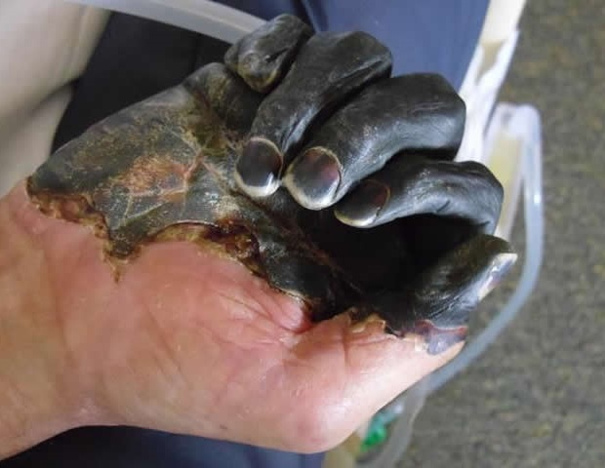

Slide 6


Slide 7
but seriously…
Case 1 appealed to us, as mentioned; we didn’t know a great deal about the functional requirements of a hospitals IT system, case 1 represented a learning opportunity for us, and a challenge.
It was a flexible option, with a variety of possible approaches.

Slide 8
Assumptions?
Due to out limited knowledge on the topic, research would be required.
The type of hospital (Public, private etc.) would affect how our system was designed.
The system will handle sensitive data, security will be a priority.
How soon would the hospital need the system implemented and running?
Do they already have an IT system in place?

Slide 9
Input & output
Hospital Staff Input & Output
Input | Output
Staff member Details (Add new member to system)
Finalise appointment times | Appointment information
Appointment info (Should a patient make an appointment over the phone), patient name, medical details, time, date etc. | Provider report for calculating profit (MTD & YTD)
Staff ‘punch in, punch out’ - track hours worked | Monthly patient statement
Staff leave request | Leave request outcome
Request appointment information | Daily report call list/appointment list
Request provider report | Cost/profit, organised by doctor, profit distribution (accounts?)
Request patient statement | Return Patient statement

Slide 10
Patient/Client input & output
Input | Output
Request Records/Medical Information | Return Records/Medical Information
Request Appointment Information | Return appointment information
Update personal data > | Return personal data
Invoice/payment of medical bill > | Payment confirmation
Appointment Scheduling > | Chosen time for appointment (confirmation)
Automated Outputs
Text message/email alert – upcoming appointment (Patients)
Text message/email alert – patient overdue for appointment (Staff)
Alert to staff – MTD/YTD available

Slide 11
control/security
Separate levels of security for users and system administrators.
All clients will require a unique login number, accompanied with a password and email address.
Other details will also be required upon adding a patient to the system, for security reasons. A TFN, mobile number or a copy of photo ID (Passport, driver’s license or photo identity card) will be required.
Patient information will be strictly private. Patients can only access their own individual records and appointment information.
The system will permit only authorized members who are listed as Administration Managers to access patient information as required and complete administrator level tasks.

Slide 12
Tasks;
Task | Task ID | Duration (days) | Start | End | Predecessor?
Form committee | 1 | 1 | Day 1 | Day 1 | None
Choose case study | 2 | 1 | Day 1 | Day 1 | Task 1
Consult with hospital staff /respected heads of faculties | 3 | 2 days (depending on staff availability) | Day 2 | Day 4 | Task 2
Determine Hospital requirements | 4 | 1 | Day 5 | Day 5 | Task 3
Brainstorming | 5 | 1 | Day 6 | Day 6 | Task 3 + 4
Define use cases | 6 | 1 | Day 6 | Day 6 | Task
Begin modelling; | 7 | 3 | Day 7 | Day 10 | Task 5 + 6
Design database | 8 | 2 | Day 11 | Day 13 | 7
Design overall architecture | 9 | 2 | Day 14 | Day 16 | 7
Design UI | 10 | 2 | Day 14 | Day 16 | 7
Design Logic | 11 | 2 | Day 14 | Day 16 | 7
Design details | 12 | 3 | Day 17 | Day 20 | 8
Perform Functional tests | 13 | 4 | Day 21 | Day 25 | 8 - 12
User acceptance test | 14 | 2 | Day 26 | Day 28
Software rollout | 15 | 2 | Day 29 | Day 31 | All

Slide 13
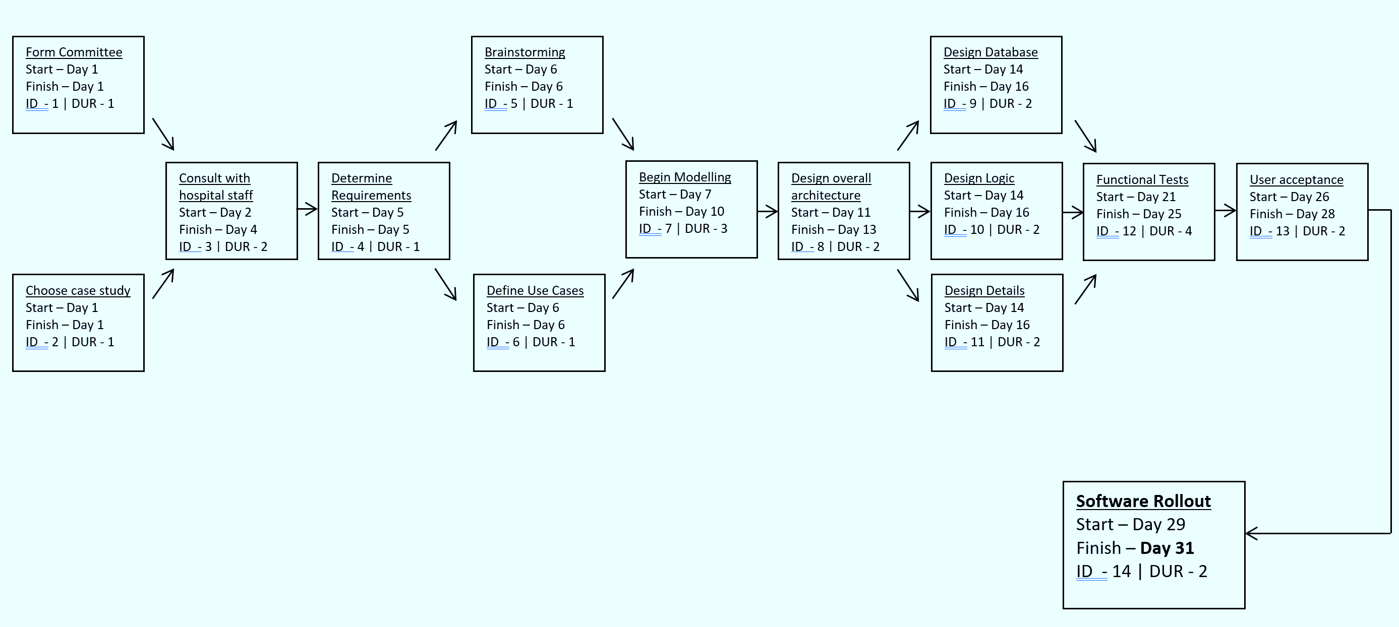
PERT/CPM Chart
Total Duration = 31 days.

Slide 14
Context diagram
HUMAN RESOURCES
PAYROLL
EMPLOYEE SCHEDULE
DAILY REPORT CALL LIST
CUSTOMER
WORK/HOLIDAY HOURS
CONFIRM APPOINTMENTS
WORK/HOLIDAY HOURS
INVOICES
INFORMATION SYSTEM
0
UPDATE PERSONAL INFORMATION
PAYMENTS
PAYMENT INFORMATION
WEEKLY PROVIDER REPORTS
CUSTOMER PAYMENT SUMMARIES
MEDICAL STAFF
ACCOUNTS RECEIVABLE
DAILY APPOINTMENT LIST
PARTNER PROFIT SHARE REPORT
STAFF AVAILABILITY
MONTHLY PATIENT STATEMENTS
WEEKLY HOURS/PROFIT

Slide 15
Data flow diagram 0
HUMAN RESOURCES
APPOINTMENT REQUEST
INFORMATION ACCESS REQUEST
UPDATE CUSTOMER INFORMATION
5
APPOINTMENT INFORMATION
CUSTOMER INFORMATION
CUSTOMER
NEW INFORMATION
CREATE APPOINTMENT LISTS
1
EMPLOYEE LIST
INFORMATION CHANGE REQUEST
EMPLOYEE AVAILABILITY
DENIED TRANSACTION
CREATE EMPLOYEE SCHEDULE
2
CUSTOMER LIST
APPOINTMENT LIST
INVOICE
CREATE REPORT CALL LIST
CONTINUE OR FINALISE PAYMENT
3
APPOINTMENT REMINDER
6
INSURANCE & PAYMENT TYPE
VACATION/SICK LEAVE
EMPLOYEE SCHEDULE
MEDICAL STAFF
ACCOUNTS RECEIVABLE
COMPOSE MTD & YTD PROFIT REPORTS
4
FULL OR PARTIAL PAYMENT
COMPLETE REPORT
COST/PROFIT OF APPOINTMENT
CONFIRMED TRANSACTION
WAGES
PAYROLL
CALCULATED VACATION / SICK LEAVE
LOGGED HOURS
APPOINTMENT DETAILS AND RESULT

Slide 16
Functional primitive for payment
FINALISE PAYMENT
6.2
D1 INSURANCE INFORMATION
FULL PAYMENT
CLAIM INFORMATION
CONFIRMED FINAL PAYMENT
VERIFY PAYMENT TOTAL
PARTIAL PAYMENT
PAYMENT
6.1
CUSTOMER
ACCOUNTS RECEIVABLE
PREPARE INVOICE
6.4
INVOICE
ACCEPTED PAYMENT
VERIFY PAYMENT
RECEIVED PAYMENT
6.3
PREPARE REJECTION NOTICE
6.5
REJECTION NOTICE
REJECTED PAYMENT

Slide 17
Data flow for dfd
Data Name | Description | Origin | Destination
Appointment list | Personal list of appointments for each member of the medical staff | Create appointment lists | Medical staff
Vacation/sick leave | Request by staff for paid leave | Medical staff | Create employee schedule
Employee availability | Information regarding which employees are available and when | Create employee schedule | Human resources
Employee list | Most appropriate available employees for writing schedules | Human resources | Create employee schedule
Employee schedule | Schedule of the employees for the day, including required work time | Create employee schedule | Medical staff
Logged hours | The total confirmed hours worked by each employee | Medical staff | Payroll
Wages | Payments made to the staff for hours worked/leave taken | Payroll | Medical staff
Calculated vacation/sick leave | Calculation of the amount of paid leave hours owed to each employee | Payroll | Medical staff
Appointment details and result | Description of procedures performed and results determined by appointment | Medical staff | Update customer information
Cost/profit of appointment | Net profit gained / loss incurred from appointment | Medical staff | Compose MTD & YTD profit reports

Slide 18
Data flow for dfd cont.
Data Name | Description | Origin | Destination
Complete report | Reports to be presented by accounting | Compose MTD & YTD profit reports | Accounts receivable
Appointment request | Request by customer to book an appointment at a desired time | Customer | Human resources
Customer list | List of customers with upcoming appointments | Human resources | Create report call list
Appointment reminder | Reminder to the customer that they have an appointment that day | Create report call list | Customer
Information access request | Request by the customer to access and review their personal information | Customer | Update customer information
New information | New or updated personal information confirmed by the customer | Customer | Update customer information
Customer information | Stored medical/personal information about the customer | Update customer information | Customer
Information change request | Automated or prompted request that the customer change or update their info | Update customer information | Customer
Insurance & payment type | The details of a customer’s insurance, and payment amount and method | Customer | Continue or finalise payment
Full or partial payment | Any payment made by the customer to the hospital, partly or in full | Continue or finalise payment | Accounts receivable

Slide 19
Data flow for dfd cont.
Data Name | Description | Origin | Destination
Confirmed transaction | Transaction accepted | Accounts receivable | Continue or finalise payment
Denied transaction | Transaction refused or cancelled, and explanation why | Accounts receivable | Customer
Invoice | Details of confirmed transaction | Continue or finalise payment | Customer

Slide 20
Data flow for functional primitive
Data Name | Description | Origin | Destination
Claim information | Information about the claim being made by the customer | Customer | Insurance information
Payment | Amount to be paid in regard to the claim | Insurance information | Verify payment total
Partial payment | Less than total amount to be paid off the balance | Verify payment total | Accounts Receivable
Confirmed final payment | Confirmation that the amount to be paid is total | Verify payment total | Finalise payment
Full payment | Total amount of balance to be paid off | Finalise payment | Accounts Receivable
Received payment | Amount paid to the organisation | Accounts Receivable | Verify payment
Accepted payment | Payment approved by the organisation | Verify payment | Prepare invoice
Rejected payment | Payment denied by the organisation | Verify payment | Prepare rejection notice
Invoice | Report of payment(s) from the customer | Prepare invoice | Customer
Rejection notice | Report detailing why the payment was not accepted | Prepare rejection notice | Customer

Slide 21
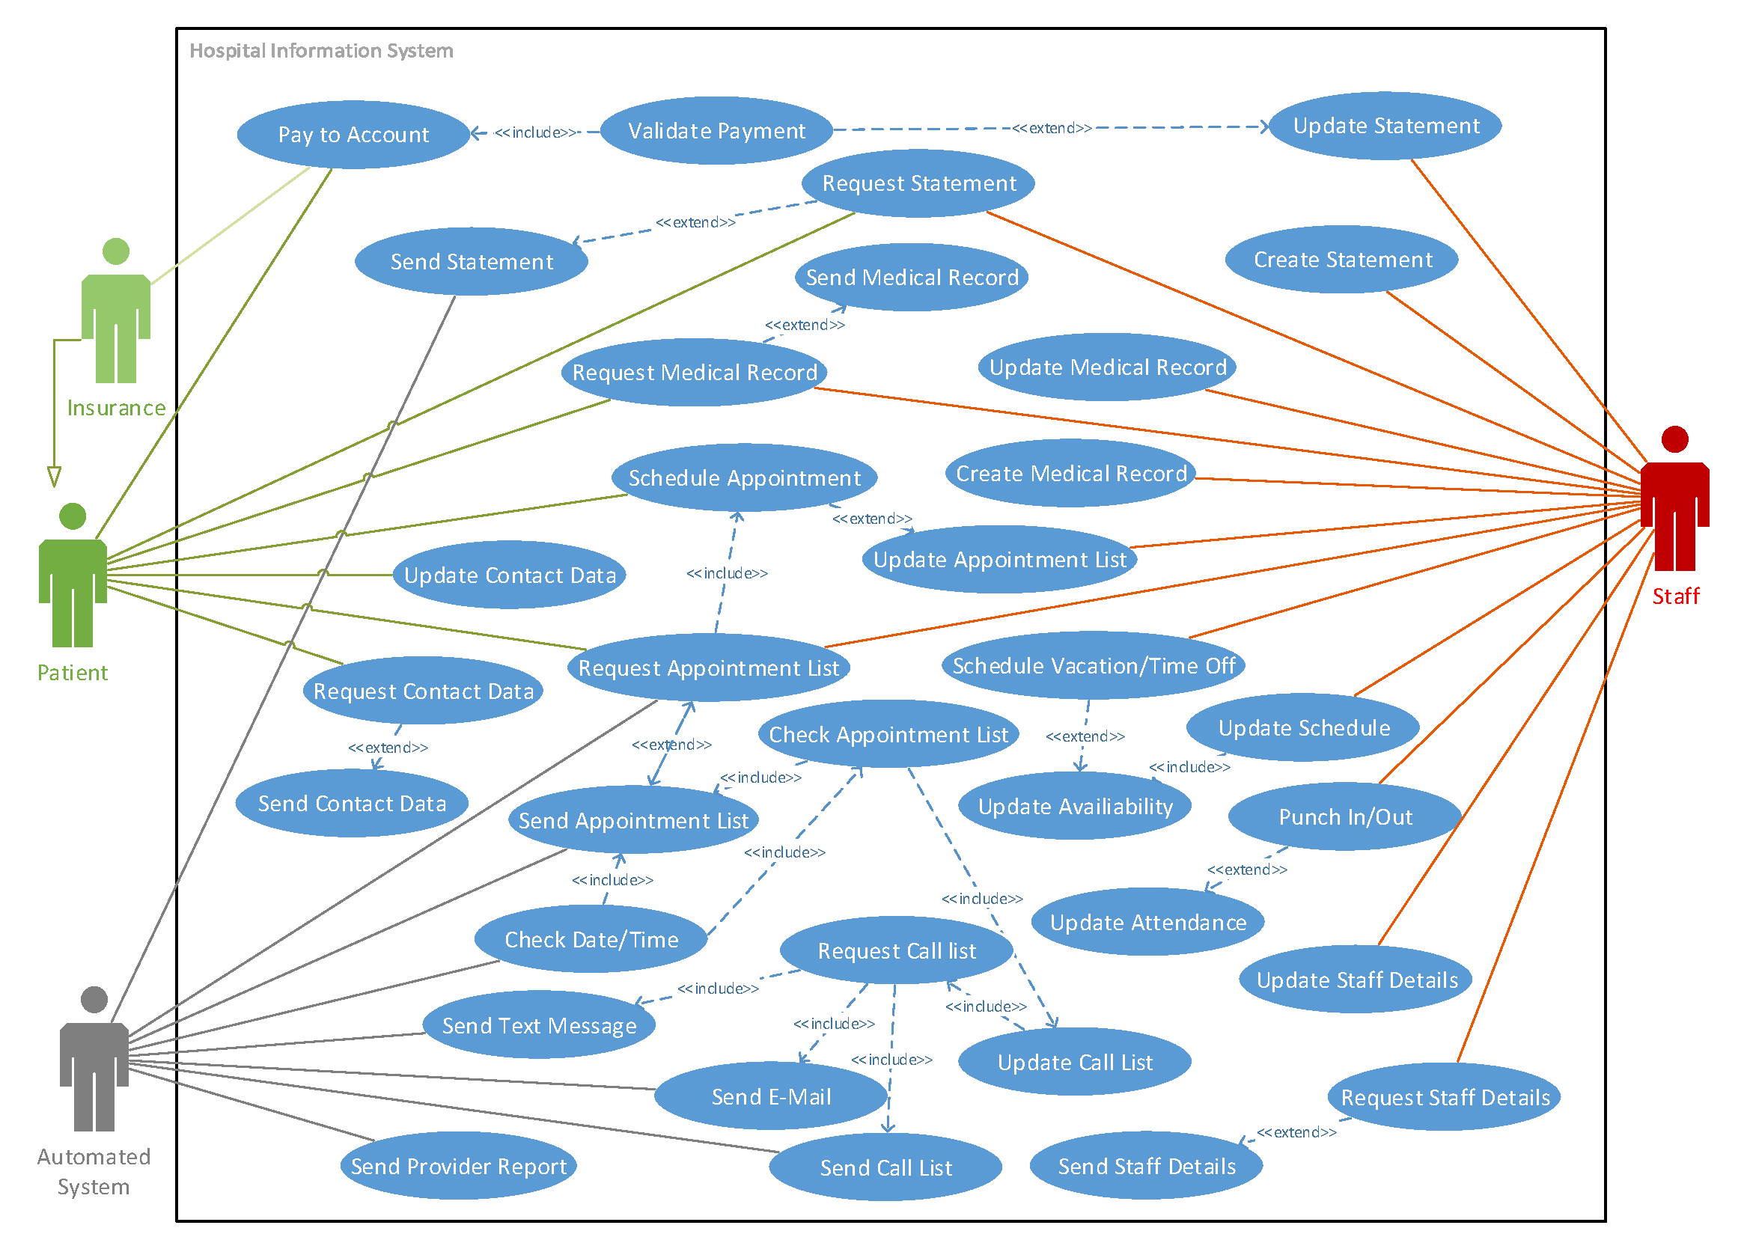
USE CASE DIAGRAM

Slide 22
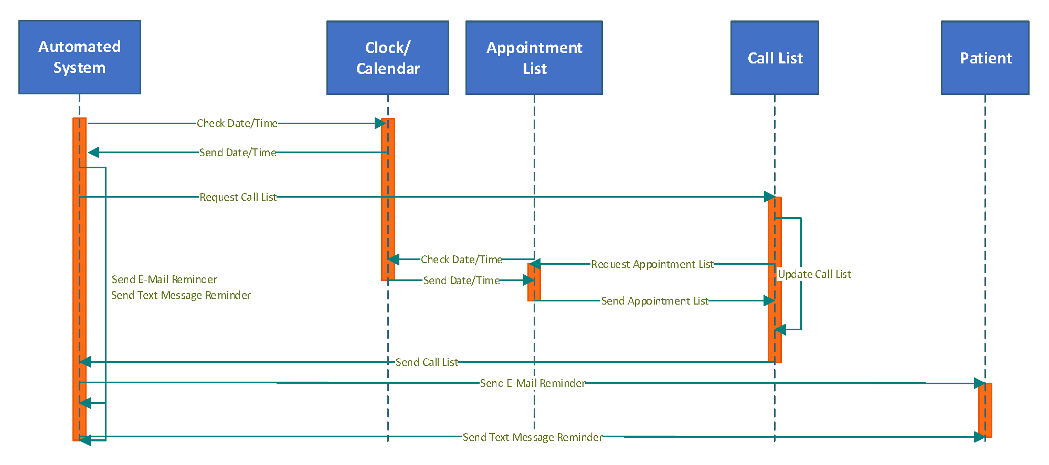
SEQUENCE DIAGRAM
AUTOMATED PATIENT
REMINDER SYSTEM

